Slide 1
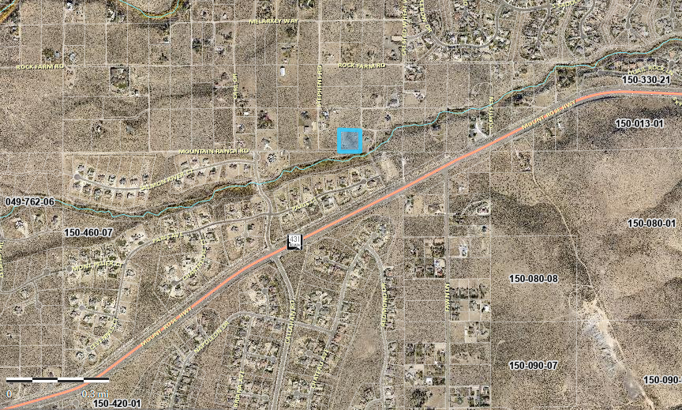
WAB20-0003 Feulner Residence
Washoe County Planning Commission
April 6, 2021

Slide 2
Background/Request
The applicant is requesting to abandon a 33ft roadway and public utility easement along the eastern boundary of the parcel and providing a replacement 7.5ft public utility easement.
The property has a High Density Rural regulatory zone.

Slide 3
Vicinity Map

Slide 4
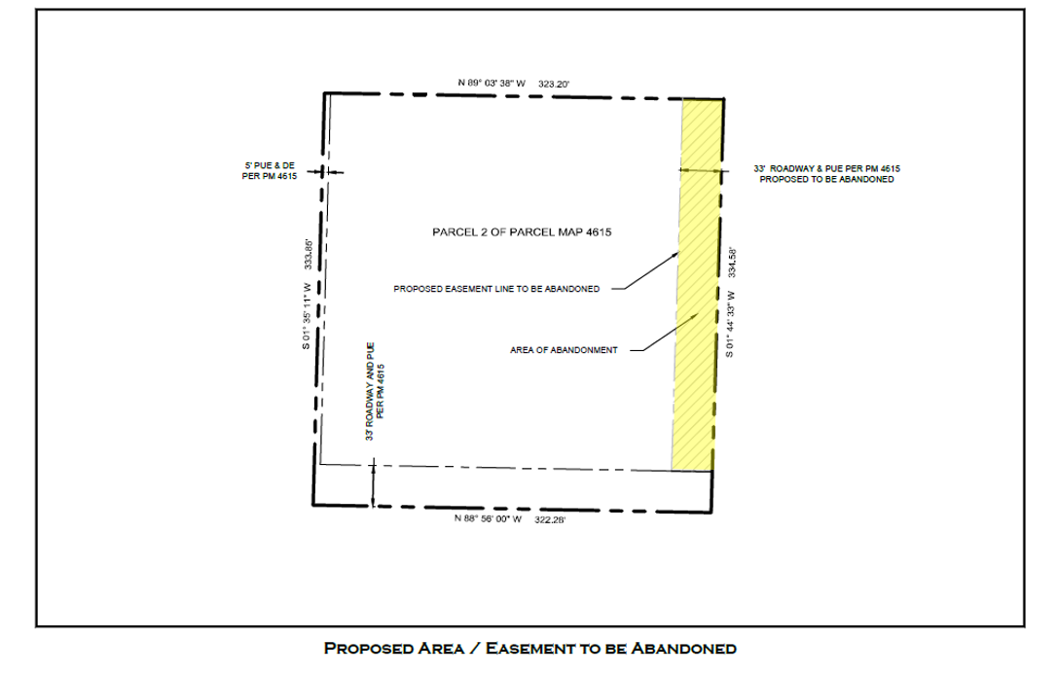
Abandonment Details

Slide 5
Analysis
Proposed easement to remove serves APN 150-250-39 and 150-250-45
150-250-39 can be accessed by Mountain Daisy and Stephens Rd
150-250-45 can be accessed via Mountain Ranch Rd.
Staff recommends replacement 7.5ft PUE as a condition of approval.
Applicant proposed 7.5ft replacement easement

Slide 6
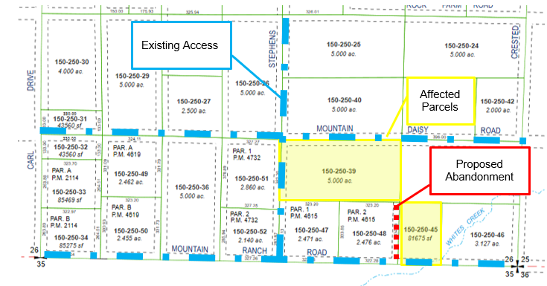
Analysis

Slide 7
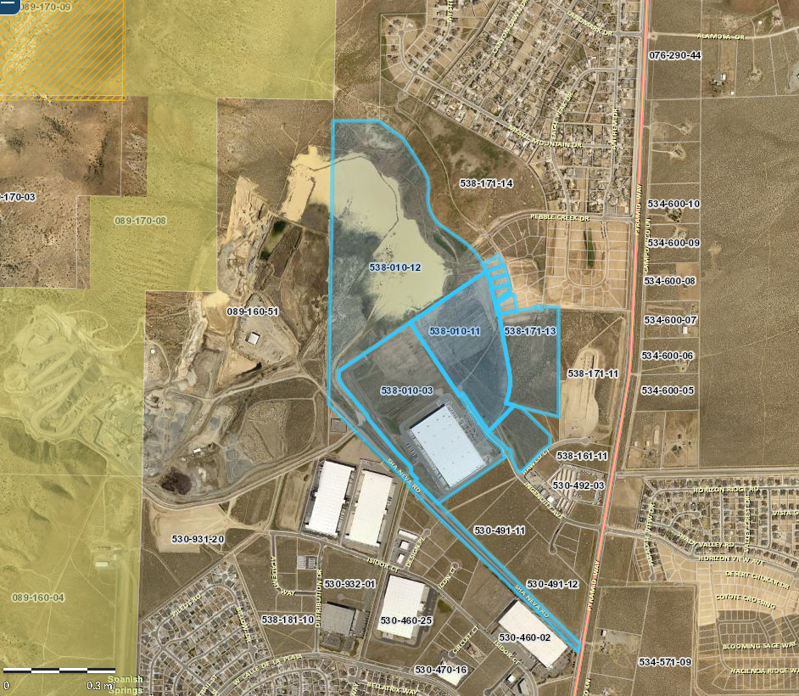
Public Notice & CAB
Notice sent to 7 affected property owners adjacent to the proposed abandonment.
WAB19-0003 Public Notice Map

Slide 8
Citizen Advisory Board
South Truckee Meadows/Washoe Valley CAB Meeting on March 4, 2021
Concerns over access to northerly parcels
Noted there was additional access
CAB voted unanimously in favor of the abandonment

Slide 9
Abandonment Findings
Master Plan. The abandonment or vacation is consistent with the policies, action programs, standards and maps of the Master Plan and the Spanish Springs Area Plan
No Detriment. The abandonment or vacation does not result in a material injury to the public.
Existing Easements. Existing public utility easements in the area to be abandoned or vacated can be reasonably relocated to provide similar or enhanced service.

Slide 10
Recommendation – Abandonment
Those agencies which reviewed the application recommended conditions to address applicable codes and impacts associated with the project. After a thorough analysis and review, staff recommends that the Planning Commission carefully consider all aspects of Abandonment Case Number WAB21-0003 and the nature of the stringent recommended conditions of approval and approve the requested abandonment.

Slide 11
Possible Motion - Abandonment
APPROVAL: I move that, after giving reasoned consideration to the information contained in the staff report and information received during the public hearing, the Washoe County Planning Commission approve Abandonment Case Number WAB21-0003 for Christopher and Megan Feulner having made all three findings in accordance with Washoe County Code Section 110.806.20, and a fourth finding in accordance with Nevada Revised Statutes 278.480(3):

